Slide 1



Concepts of Integration and
BizTalk Server for SOA and BPM
Sandro Pereira @DevScope

Slide 2
Agenda
Intro
1
Concepts of Integration
2
BizTalk Server for SOA and BPM
3
Integration Challenges
Types of Integration
Integration Infrastructure
Introduction to BPM and SOA
BizTalk Server Capabilities
BizTalk Enterprise Ready Architecture
BizTalk Artefacts
Concepts

Slide 3
Introduction
The growing needs for information availability and accessibility present new challenges for application development.
Stand-alone applications cannot fulfill the growing needs anymore
Integrating applications is a difficult task.
Ideally, a well-integrated system should offer end-to-end support for business processes with instant access to information, no matter which part of the system is used .
Notes:
STAND-ALONE
It is necessary to allow for application integration within an enterprise, and, there are growing needs to ensure inter-enterprise or "business-to-business" integration.
DIFFICULT TASK
To fulfill these integration objectives, several methods, techniques, patterns, and technologies have been developed over the years, ranging from point-to-point integration over enterprise application integration (EAI) and business process management to service oriented architectures (SOA).

Slide 4


Concepts of Integration

Slide 5
Integration Challenges
Different applications, developed over time
Applications developed inside the company
Custom-built but outsourced solutions
Commercial and ERP applications
Different platforms, using different technologies and programming languages
Mix of programming languages
Different types of database management systems and products
Different middleware solutions for communication
Multiple information transmission models,
Different transaction and security management middleware
Different ways of sharing data
Possible usage of EDI, XML, and other proprietary formats for data exchange
…
Notes:
Integration seems to be one of most important strategic priorities, mainly because new innovative business solutions demand integration of different business units, enterprise data, applications, and business systems
Companies will typically have different applications, developed over time. These include:
Applications developed inside the company
Custom-built but outsourced solutions
Commercial and ERP applications
These applications have typically been developed on different platforms, using different technologies and programming languages
Mix of programming languages
Different types of database management systems (relational, hierarchical, object) and products
Different middleware solutions for communication (message-oriented middleware, object request brokers, remote procedure calls, etc.)
Multiple information transmission models, including publish/subscribe, request/reply, and conversational
Different transaction and security management middleware
Different ways of sharing data
Possible usage of EDI, XML, and other proprietary formats for data exchange

Slide 6
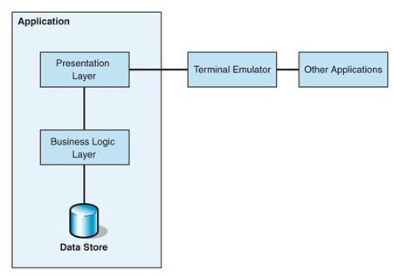
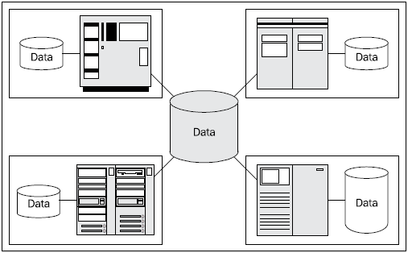
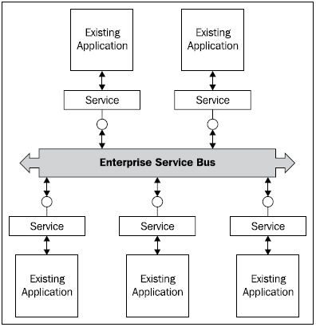
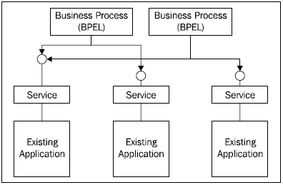
Types of Integration
Today integration can be seen in several layers. We usually start building the integration architecture at the lowest layer and climb gradually.
The most important types of integration are:
Data-level integration
Application integration
Business process integration
Presentation integration
Business-to-Business Integration (B2B)
Notes:
Data-Level Integration
Data-level integration focuses on moving data between applications with the objective of sharing the same data among these different applications. It is often the starting point where a company starts to work on integration.
Application Integration
Application integration focuses on sharing functionality—business logic; and not just pure data as in data-level integration. Application integration is usually achieved through the use of application programming interfaces (APIs). Applications that expose their functionality through APIs enable access to the functionality in a programmatic way without using the user interface.
Business Process Integration
Business process integration enables non-compromise support for business processes in the enterprise where existing solutions take part in distinctive steps of the business process. It exposes the functionality as abstractions of business methods through interfaces.
Business process integration presents the enterprise-wide information system as we would like to have it—or as we would build it if we could build it anew, with clear requirements for what we would like to get from the integrated system and with the knowledge and support of modern technologies
Those existing applications are remodeled in a way that they expose the functionality of the business process tier and fit into the modern application architecture. Finally, the different pieces are glued together, usually by using a business process modeling and execution language, such as BPEL (Business Process Execution Language)
Presentation Integration
Presentation integration results in an integrated system that provides a unified presentation layer, through which the users can access the functionality of the integrated system.
Business-to-Business Integration
Today, the integration of applications inside a company is not sufficient. There are growing needs to enable inter-enterprise integration, often referred to as business-to-business (B2B) integration, or e-business. E-Business places particular new challenges for an information system.

Slide 7
Integration Infrastructure
If we focus on the required infrastructure services for integration, we can separate the services in 2 layers: horizontal and vertical layer.
The services in horizontal layers will provide basic infrastructure services useful for the majority of existing and new-generation applications.
The vertical layer services will provide functionalities related to a specific task within infrastructure that can span through several horizontal layer services
Business intelligence
Transformation
Transactions
Security
Lifecycle
Naming
Scalability
Management
Rules
Brokering and routing
Communication
Notes:
Communication
The primary responsibility of the communication service is to provide the abstraction for communication details. It provides the transparency for accessing different remote systems and unifies the view on them
Brokering and Routing
The brokering and routing layer takes care of implementing the technical side of integration. No matter what type of integration we use, this layer should adapt the communication between applications in such way that all participating applications will be able to interoperate. This layer is essential for integration and actually has a number of responsibilities.
Transformation
Transformation of data structures, their representations, and technologies has always been very important. In the past, small, custom-written programs that have read the source and transformed it to the destination format have usually solved the problems related to the transformation. With the advent and global use of markup languages, particularly XML, which has become the de-facto standard for data exchange, transformations have achieved a new level of maturity
Business Intelligence
The business intelligence layer is responsible for presenting the high-level interface to access business information to other applications and to the users. The business-intelligence layer presents data to users in an understandable form. With the growth of e-commerce, the business-intelligence layer also takes some responsibilities for B2B integration.
Transactions
The integration infrastructure has to provide the means for carrying out the business operations in a transactional manner. Therefore, it has to be able to invoke several operations on different existing and new-generation systems. It has to support the atomic ACID transaction model and long-running transactions with compensation semantics, usually referred to as business activities
Security
The integration infrastructure has to provide ways to constrain access to the system. Similarly, as the integration infrastructure horizontal services define a unified way to access the different applications, they should also define a way in which to manage security, possibly in a declarative way. The security should include all four horizontal layers. It should be able to reuse the existing application security, and base the security on roles that are defined with a single user log in. The security system should not be based on different passwords for different applications or even parts of applications. It should relate to all the important aspects, like communication channel encryption, authentication, authorization, and auditing.
Lifecycle
The integration infrastructure should provide ways to control the lifecycle of all applications involved. It should enable existing applications to be replaced one by one or even by parts without having influence on the other applications in the integrated system. The replacement should be possible step by step, when business needs dictate it and when enough resources are available. It should also provide ways to do the replacement while the system stays online
Naming
A unified naming service will allow for the implementation of location transparency and will enable the replacement of one resource with another if this is required. The naming service in usually implemented with a naming and directory product that enables storing and looking for name-related information. Ideally, the naming service is unified and provides one logical picture of the enterprise, although it is physically implemented using replication and distribution to avoid a single point of failure.
Scalability
The integration infrastructure should be designed with scalability in mind. It has to access information about clients and provide concurrent access to the applications. It has to incorporate solutions that will enable enough room for extending the load demands on the system.
Management
We also have to provide ways to manage the integration infrastructure. Many solutions, particularly custom applications, leave this out, which results in difficulties at the maintenance stage. The management layer should provide methods and tools to manage horizontal and vertical services. It should provide easy configuration and version management.
Rules
The horizontal services require specific rules for performing communication, brokering, routing, and business-intelligence tasks. These rules should not be hard-coded into applications, but should rather be declaratively specified inside the integration infrastructure. This includes the definitions, data formats, data transformations and flows, events, information processing, and information representation. Often these rules are stored in a repository, which provides a centralized storage to avoid duplication and inconsistencies.

Slide 8
BizTalk Server for SOA and BPM

Slide 9
Introduction to BPM and SOA

Slide 10
Business Process Management (BPM)
Is a field of management focused on aligning organizations with the wants and needs of clients.
It is a holistic management approach that promotes business effectiveness and efficiency while striving for innovation, flexibility and integration with technology.
Business process management attempts to continuously improve processes. It could therefore be described as a "process optimization process”.
Enable business processes that drive new capabilities and competitive agility
Allow business workers to access and manage these processes
Abstract business rules – to enable declarative control
Notes:
O Business Process Management (BPM), gestão por processos de negócios, tem como objectivo prover o alinhamento dos processos de negócios com a estratégia (os processos são a execução da estratégia), os objectivos e a cadeia de valor das organizações.
Um processo de negócio pode ser caracterizado como um conjunto de tarefas que envolve pessoas e recursos para que possa se atingir um objetivo previamente traçado. Como resultado deste, é gerado um produto ou serviço que vai ao encontro dos desejos dos clientes. Muitas empresas não dão a importância devida a estes processos, o que se caracteriza em um grande erro, uma vez que estes são cruciais à sua sobrevivência.

Slide 11
Service-Oriented Architectures (SOA)
What is SOA?
A service-oriented architecture is essentially a collection of services. These services communicate with each other. The communication can involve either simple data passing or it could involve two or more services coordinating some activity.
SOA and Web Services: Two Complementary Talents
Although Web services do not necessarily translate to SOA, and not all SOA is based on Web services, the relationship between the two technology directions is important and they are mutually influential: Web services momentum will bring SOA to mainstream users, and the best-practice architecture of SOA will help make Web services initiatives successful.
Notes:
Service-oriented architecture (SOA), pode ser traduzido como arquitectura orientada a serviços, e é um estilo de arquitectura de software cujo princípio fundamental preconiza que as funcionalidades implementadas pelas aplicações devem ser disponibilizadas na forma de serviços.
O termo "Service-Oriented Architecture" (SOA) ou Arquitectura Orientada a Serviços expressa um conceito onde aplicativos ou rotinas são disponibilizadas como serviços em uma rede de computadores (Internet ou Intranets) de forma independente e se comunicando através de padrões abertos. A maior parte das implementações de SOA se utilizam de Web services ( SOAP , REST e WSDL). Entretanto, uma implementação de SOA pode se utilizar de qualquer tecnologia padronizada baseada em web.
Freqüentemente estes serviços são organizados através de um "barramento de serviços" (enterprise service bus, em inglês) que disponibiliza interfaces, ou contratos, acessíveis através de web services ou outra forma de comunicação entre aplicações

Slide 12
BizTalk Server,what is and is Capabilities

Slide 13
BizTalk Server Capabilities
O BizTalk Server é o principal servidor da Microsoft para a construção de soluções de integração de sistemas e processos empresariais.
O produto vai no seu sexto grande lançamento, que tem como base a inovação e o sucesso introduzido pelos lançamentos anteriores: BizTalk Server 2000, 2002, 2004, 2006 e 2006 R2.

Slide 14
Generic Integration Scenarios for BizTalk
Web
App
Desktop
App
Client App
Client App
Partner
Service
Service Aggregator
Long Running
Business Process
Enterprise Rule Repository
B2B Process
Service Aggregator
Long Running Business Process
Partner
Service
B2B Process
Abstraction of Rules from Business Process
Rules
Enterprise Rule Repository
Event Initiated Process
RFID Device
LOB
Application
Line of Business
Application
Service
LOB
Application
Custom Legacy
Application
Service
LOB
Application
Database/
Message Queue
Service
Line of Business
Application

Slide 15
BizTalk Server Capabilities
Management and Operations
Business Rule Framework
Business to Business Integration
Business Activity Monitoring
Orchestration
Messaging
Tools
RFID Platform

Slide 16
Messagging
Inbound
Durable Messaging
Outbound
Service Enablement
Enterprise Single Sign-On
Message Security
Message Assembly/ Disassembly
Pluggable Adapters
Notes:
The messaging subsystem provides communication with a wide range of external applications through adapters. Dozens of adapters are supplied, free of charge with BizTalk Server 2006 R2 to handle proprietary protocols and to support the conversion to and from different data formats. Windows Communication Foundation (WCF) provides standards-based service enablement for BizTalk endpoints through WCF adapters and for Line-of-Business (LOB) applications through the WCF LOB adapter SDK. Messages are received and sent by BizTalk inbound and outbound endpoints. These endpoints provide versatile capabilities for parsing and handling messages as they flow in and out of BizTalk such as: message encoding and decoding, schema validation, and message de-batching and assembling. The messaging capabilities include a scalable, durable storage that enables publish / subscribe mechanism as well as robust and fault tolerant message routing. It includes single-sign-on capabilities and message security features such as encryption and decryption, signing, and verifying message signature.
1. Inbound Message Security
Inbound message security spans from the point where message is read from channel to the point where it is published into message box. Inbound message can be secured in two ways – Encryption and Digital Signature. These configurations are done at two stages of receive pipeline – Decode and Resolve Party
2. Outbound Message Security
Akin to inbound messages, BizTalk also facilitates in secure data transmission from its premises. Outbound messages can be encrypted/digitally signed to make sure that only authorized parties/partners could consume them
Durable Messaging
One of the major features of BizTalk Server 2006 is its durable messaging engine, which is centered around the BizTalk Server 2006 MessageBox database. Because of the topology of the messaging engine, messages can be routed dynamically to different services running on different machines, without risking message loss.
Key Capabilities:
Efficient processing of incoming and outgoing messages
Connectivity to disparate systems with more than 25 included adapters
Support for a variety of file formats and transport protocols
Advance message transformations and routing options
Durable messaging including publish/subscribe engine
Enforcement of message-level security
Key Benefits:
Leverage existing applications as reusable services
Simplifies interoperability
Shields effects of endpoint changes
Reduce risk from application dependencies
Provides high quality of service for reliable, traceable, and secure messaging

Slide 17







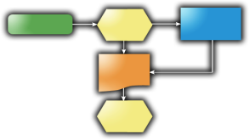

Orchestration Service composition
Flow Control
Port Binding
Scopes
Design Patterns
BizTalk
ERP
HR
E-Commerce
CRM
Notes:
Orchestrations allow for service composition in a declarative way (using visual shapes) to implement automation of business process or systems workflow. Orchestration engine provides a rich and robust runtime infrastructure. Orchestration and messaging capabilities simplify and expedite the implementation of typical enterprise integration patterns such as dynamic message routing and aggregation of services. Implementation of service orchestration for long running business processes is made easy though the built-in features such as automatic orchestration persistence and state management and correlation of asynchronous message responses.
Key Capabilities:
Centrally managed business processes
Transactional and non-transactional message processing
Intuitive visual designer
Fault tolerant runtime execution
Key Benefits:
Automates complex messaging patterns and system workflows
Increases manageability and maintainability of process logic
Promotes agile development
Reduces change impact through separation of concerns

Slide 18
Business Rule Framework
Business Rule Authoring
Business Rule Engine (BRE)
Notes:
A full-featured Rules Framework, that promotes modularity of business logic, code reuse, and simplicity to minimize the effort of business logic updates. The framework makes it easy to develop highly declarative, semantically rich rules that link to any facts (such as .NET components, XML documents, or database tables). It also provides a forward-chaining Inference Business Rule Engine and an infrastructure to support rule versioning, deployment, and updating.
You can integrate business rules into your orchestrations to support a variety of scenarios:
Use rules instead of coding and recoding constantly changing business policies and logic within your complex business processes. Incorporate a call and allow information workers to update business rules.
Use rules to evaluate business logic and to determine when a business process requires a variable delay. For example, you might set up a loop to check on the status of an item to determine whether the item is in stock. After initially checking the stock of an item that is not available, the rule delay would be one minute. The next time, the rule would wait five minutes before executing; the time after that, the rule would wait 30 minutes before executing; and so on.
Use rules to determine the execution path for a business process, basing the determination on the results of the rule execution. For example, if a customer does not exist for a particular purchase order, you could route the document to another business process to add the customer to the database before continuing to process the purchase order
Key Capabilities:
Central repository for managing of business rules
Abstraction of external data sources through vocabulary
Seamless integration with orchestrations and .NET applications
Efficient forward chaining rule inference engine
Key Benefits:
Increases decision makers productivity through automation
Allows rapid adjustment to business changes
Provides consistent rules and behavior across systems
Enables provisioning by non-developers

Slide 19







Business-to-Business Integration
EDI Support
AS2 Support
Specify
Manufacture
Manage
Assemble
Sell
Support
Industry Accelerators
Trading Partner management
Notes:
BizTalk Server 2006 R2 includes comprehensive data exchange options to communicate with Trading Partners through industry standards. These features include integrated support within the BizTalk Server engine for Electronic Data Exchange (EDI) data (including X12, EDIFACT and HIPAA support) and Availability Statement 2 (AS2) data for EDI over the Internet.
BizTalk Accelerators speed up the development of standards based B2B solutions within specific industry segment such as: the SWIFT, HL7 and RossetaNet Accelerators.
Trading partner information and partner agreements can be stored and managed, allowing for rapid on boarding and provisioning of partners and for streamlining business communication with them.
Key Capabilities:
Enables automated electronic transactions with trading partners
Support for well-established protocols such as Electronic Data Exchange (EDI) data (X12, EDIFACT, and HIPAA) and Availability Statement 2 (AS2)
Support for specific industry protocols such as SWIFT, HL7, and RosettaNet
Key Benefits:
Reduces time to onboard new partners
Adapts to specific partner requirements
Preserves investments in legacy protocols
Caters to end-to-end Supply Chain Management solutions
Provides out-of-the-box compliance with industry standards and regulations

Slide 20
Management & Operation
Application Management
Tracking Configuration & Reporting
Host Management
Application Deployment
Best Practice Analysis
MOM Monitoring
Database Management
Notes:
BizTalk Server provides comprehensive capabilities for managing application artifacts and endpoints and for tracking of messages, process, and services. These capabilities streamline the job of administrators that need to deploy enterprise wide BizTalk applications to highly distributed environments.
The management capabilities of BizTalk Server are vital for supporting mission critical application requirements such as: scale out, fault tolerance and load balancing. To ensure the BizTalk system health and performance, a set of utilities and tools allow administrators to easily configure, monitor, and maintain the underlying infrastructure of databases, hosts, and services.

Slide 21
BizTalk 2004 – Sopa de peças (Artifacts) ☹
Desde BizTalk 2006 – Conceito de Aplicações ☺
Simplificação do deployment, gestão e resolução de Problemas
Possivel agrupar os componentes relacionados
Permite a quem gere ter uma ideia da arquitectura da aplicação tal qual o developer a desenhou

Slide 22
Business Activity Monitoring
Observation design Model
Event Observation Engine
Reporting
Notes:
Business Activity Monitoring (BAM) provides visibility on business processes by tracking process milestones and business data (KPIs). BAM allows business users and decision makers to gain insight on the current health of in-flight processes they are responsible for. Up-to-date information is accessible to users via Microsoft Office BI tools or a designated portal and through automatic business alerts. This allows users to streamline and improve daily business operations by proactively escalating issues and mitigating problems sooner.
BAM is composed of a collection of tools and runtime components to layer business tracking without having to write any code. A set of runtime interceptors capture interesting business events inside of BizTalk Application or other applications and publish those events into the BAM infrastructure.
It also provides a set of tools for managing this infrastructure, tools for aggregating and viewing the data as well as APIs to optionally publish data to through custom code.
Key Capabilities:
Observation model to reflect business metrics and key performance indicators
Event instrumentation through interceptors and APIs
Tools to design, map, and deploy your BAM solution
Built-in reporting and alerting portal
Integration with Office Business Intelligence tools, SharePoint and SQL Server Reporting Services
Key Benefits:
Increases visibility of business metrics across shared processes
Reduces costs through early problems detection and alerting
Enhances process execution performance

Slide 23







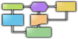







Visibility Into Distributed Processes With BAM
Business
IT Pro
BizTalk
Server
BAM
WF BAM Interceptor
BizTalk Server
WCF BAM Interceptor
Reporting Services
Notes:
Business Activity Monitoring (BAM) provides visibility on business processes by tracking process milestones and business data (KPIs). BAM allows business users and decision makers to gain insight on the current health of in-flight processes they are responsible for. Up-to-date information is accessible to users via Microsoft Office BI tools or a designated portal and through automatic business alerts. This allows users to streamline and improve daily business operations by proactively escalating issues and mitigating problems sooner.
BAM is composed of a collection of tools and runtime components to layer business tracking without having to write any code. A set of runtime interceptors capture interesting business events inside of BizTalk Application or other applications and publish those events into the BAM infrastructure.
It also provides a set of tools for managing this infrastructure, tools for aggregating and viewing the data as well as APIs to optionally publish data to through custom code.

Slide 24
Tools
Development Tools (in VS)
Admin and Operations Tools
Business Rules Tools
BAM Tools
EDI Tools (in VS)
RFID Tools
Notes:
Microsoft BizTalk RFID (Radio Frequency IDentification) is an innovative platform, designed to significantly reduce the complexity in development and deployment of RFID-based solutions. It supports the broadest range of RFID hardware devices in the market today, providing the enterprise customer with an unprecedented choice of RFID hardware through device abstraction, management and simulation. Rich event processing capabilities enable filtering, aggregation and transformation of RFID bit steams to meaningful business events. The RFID platform enables businesses to easily create, deploy, manage, and integrate their existing business processes and ERP applications with RFID technology.

Slide 25
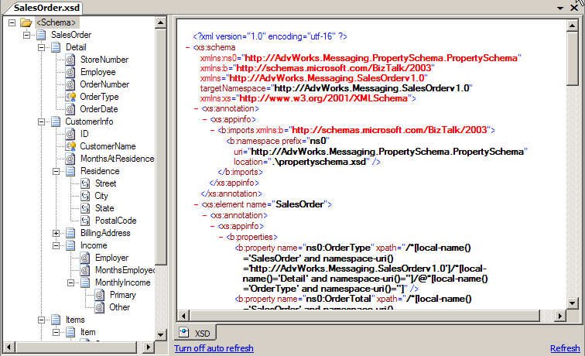
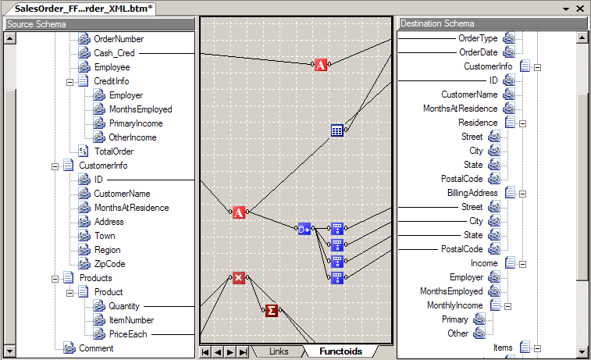
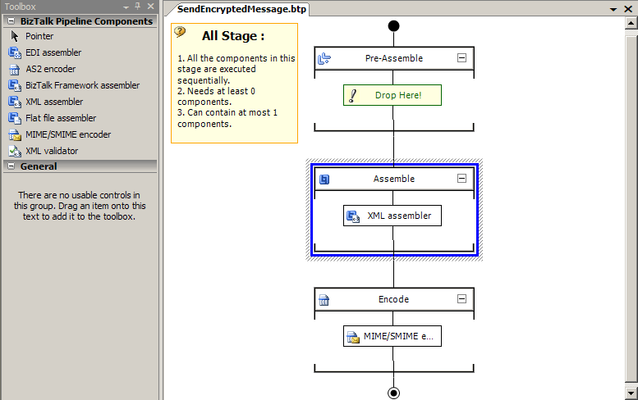
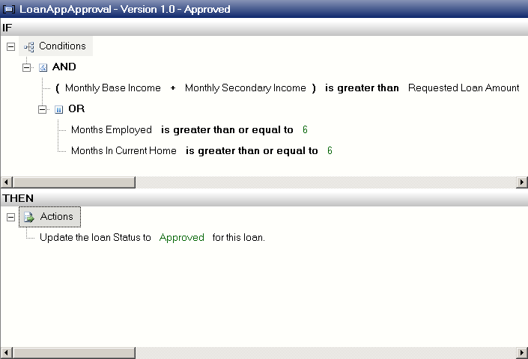
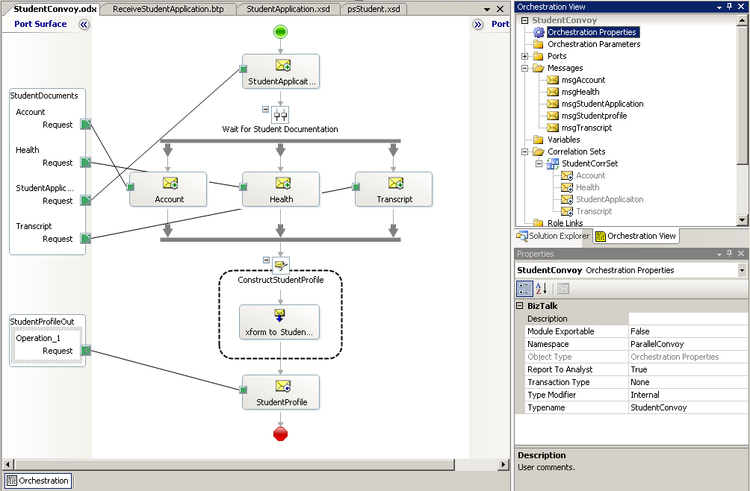
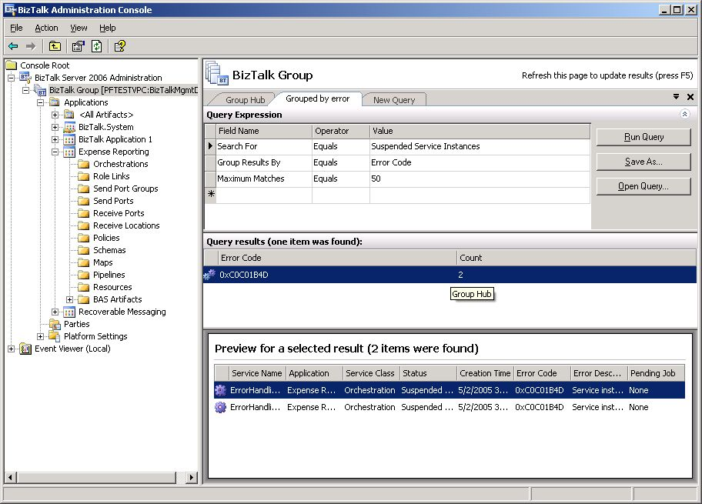
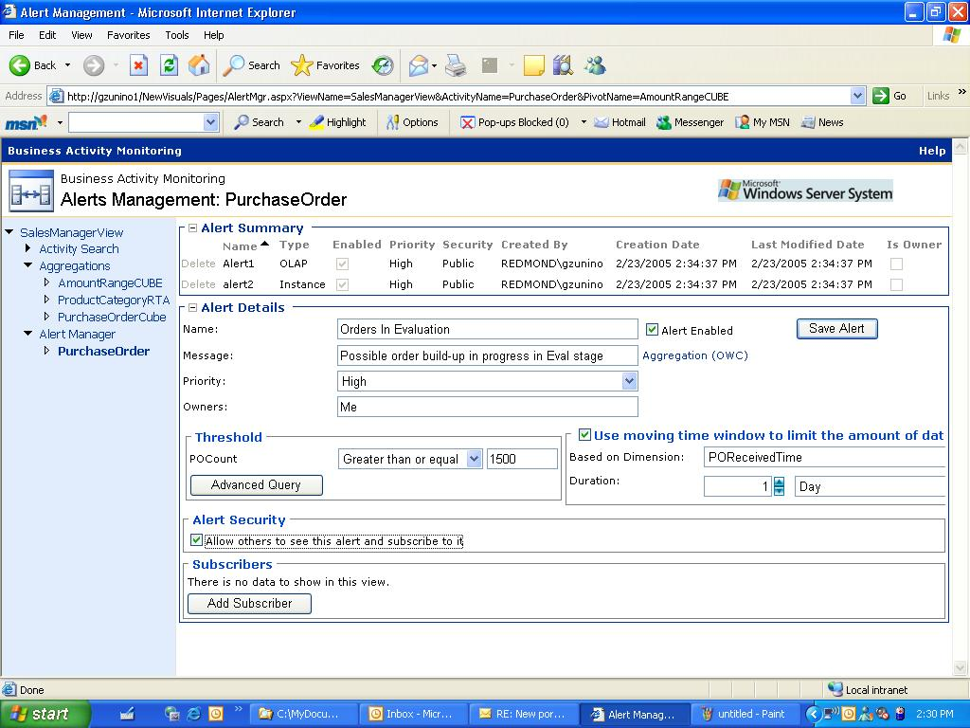
Tools

Slide 26


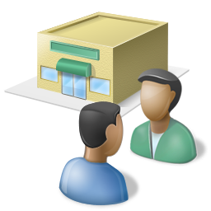














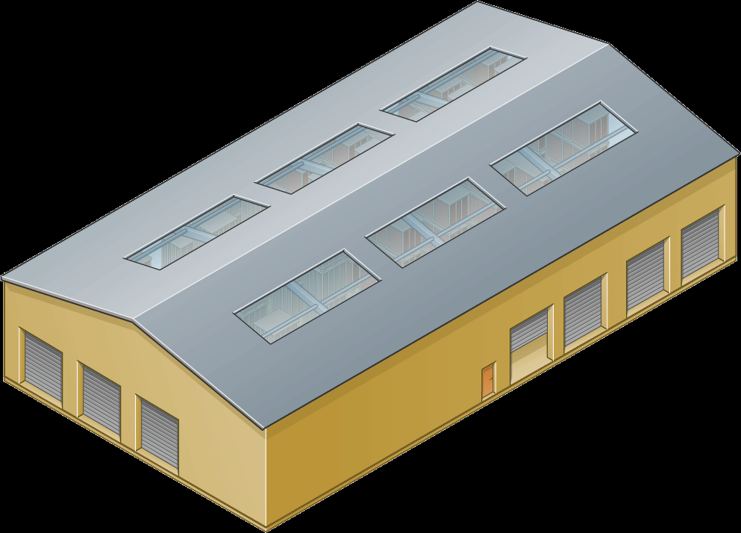

BizTalk In Supply Chain Execution Scenario
Suppliers
Send Order (AS2)
Business
Users
Retailer
Receive Shipment Notice
Manage and
Operate
EDI
Assign Supplier
Policy
Up-to-date KPIs in BAM
Re-stock Orders
Orchestration
Design and Implement
Messaging
Messaging
IT Pros and
Developers
Check DC Warehouse
Inventory
Messaging
Messaging
Receive
Requests for Re-stock
Goods Received
Update
Update ERP
DC Warehouse
Inventory System
Filter Tags
Policy
Store
Inventory System
Read Shipment RFID Tags
BizTalk
RFID
Stores
ERP System

Slide 27
BizTalk Enterprise Ready Architecture

Slide 28

BizTalk Runtime Architecture
Message
Host
Host
Host
Receive Port
Orchestration
Send Port
Adapter
Adapter
Receive Pipeline
BTS
Msg
Send Pipeline
BTS
Msg
BTS
Msg
Map
Message Box
Map
Message
BTS
Msg
BTS
Msg
BTS
Msg

Slide 29
Receive Pipeline
Notes:
Decodificar: Esse componente pode manipular mensagens e quaisquer anexos contidos nessas mensagens tanto no formato MIME quanto no formato S/MIME (Secure MIME). O componente converte ambos os tipos de mensagem para XML. Além disso, ele também pode descriptografar mensagens S/MIME e verificar suas assinaturas digitais.
Separar: São fornecidos 3 componentes padrão.
Flat File Disassembler: torna arquivos flat em documentos XML. Esses arquivos podem ser posicionais, sendo que cada registro possui a mesma extensão e a mesma estrutura, ou delimitados, com um caractere designado para separar registros no arquivo.
XML Disassembler: analisa as mensagens de entrada que já foram descritas com a utilização do XML.
BTF Disassembler: Esse componente aceita as mensagens enviadas utilizando o mecanismo de mensagens confiável definido pelo BTF (BizTalk Framework), o qual foi implementado no BizTalk Server 2000 (não é muito utilizado hoje em dia).
Validar: XML Validator, como o próprio nome já diz, esse componente valida um documento XML produzido pela etapa Separar mediante um esquema ou grupo de esquemas especificados. Um erro será retornado caso o documento não esteja em conformidade com um desses esquemas.
Determinar Partes: o único componente padrão para esta etapa, Party Resolution, tenta determinar uma identificação para o remetente dessa mensagem

Slide 30
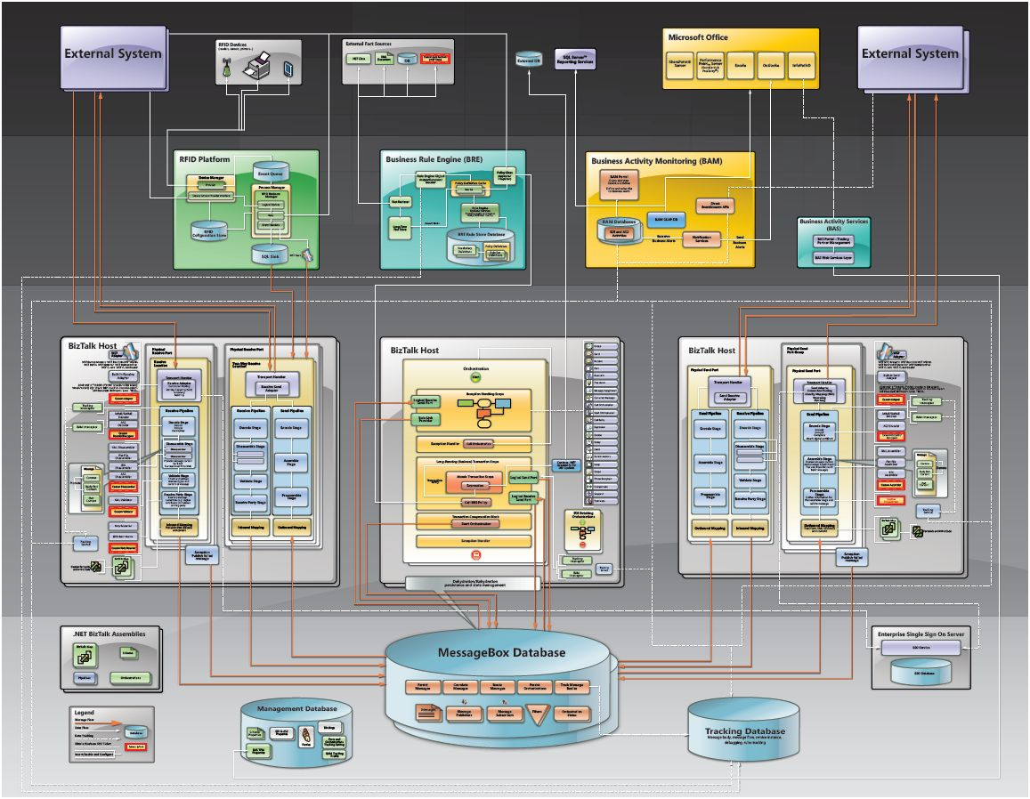
RFID
BRE
BAM
B2Bi
Messaging
Orchestration
Messaging
B2Bi
B2Bi
B2Bi
B2Bi
B2Bi
Messaging
Messaging
Messaging

Slide 31
Enterprise Ready Capabilities
Thread Management
Memory Management
Scripting and Programmability APIs
Service Isolation
Regulatory Compliance
Exception Configuration
Archiving and Purging
Failed Message Management
What’s in a BizTalk Host?
Disaster Recovery
Message Tracking
Utilization
Performance Tracking
Composite Execution Tracking
Health Monitoring
Composite State Management
Availability Monitoring
Load Balancing
Multi-environment Deployment Model
Fail-over
Configuration Management
Throttling
Identity and Impersonation
Scale-out Configuration

Slide 32




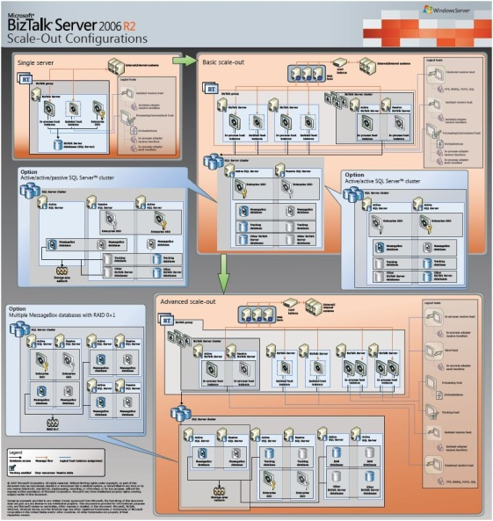

Scale-out Configurations
Basic Clustering and Load Balancing
Advanced Clustering,
Load Balancing and Multi-tier
Stand-alone

Slide 33
BizTalk RASS Capabilities
Reliability - Persistence and durability
Availability - Load balancing and fault tolerance
Scalability - Clustering and host group
Security - Message, host and role based
Business Critical
Mission Critical
High Throughput
Secure
Enterprise Ready

Slide 34
Extending The Service Bus
Service Bus
Naming
Messaging
Identity
Directory
Eventing
…
On-Premises
Cloud
Enterprise Service Bus
Internet Service Bus
BizTalk Server
On-premise SOA infrastructure for loosely-coupled communication based upon web service standards
Automation and management of business processes
Prescriptive guidance for ESB implementations available at www.codeplex.com/esb
BizTalk Services
“Firewall friendly” messaging, identity, and workflow services
Extend our server reach and capabilities for cross-organizational composite applications
CTP release of services are available today at http://labs.biztalk.net

Slide 35
BizTalk Common Artefacts

Slide 36
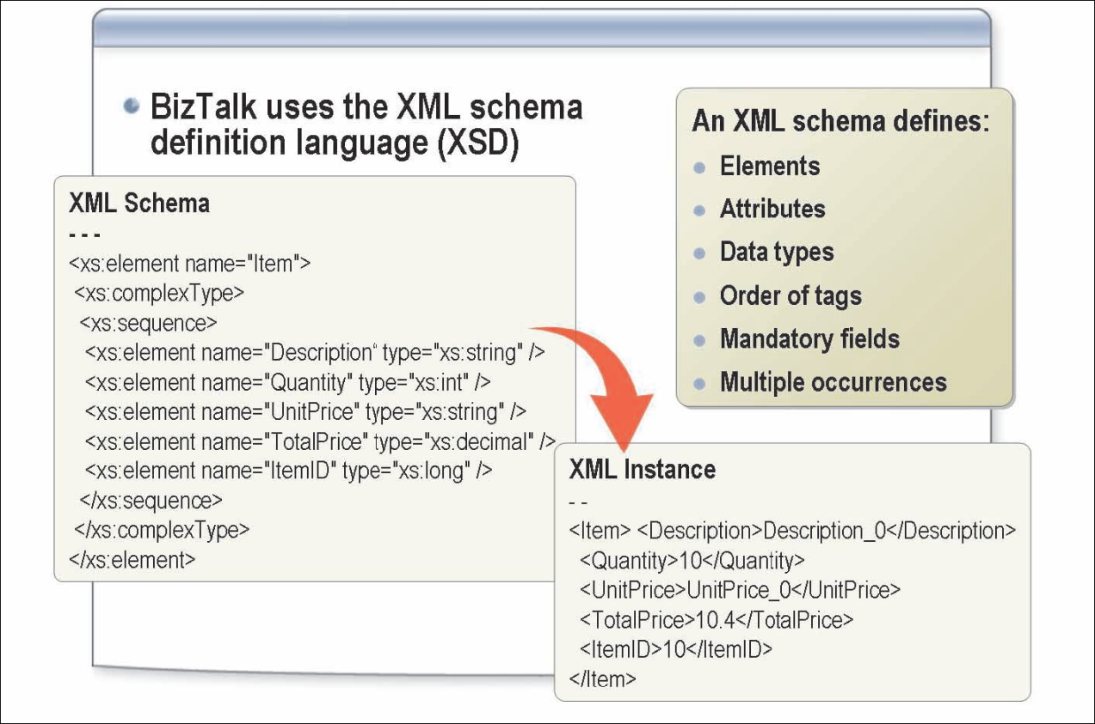
BizTalk Schema
BizTalk Server 2006 uses the XML Schema definition language (XSD) to define the structure of all messages that it processes, and refers to the definitions of message structure as schemas.
Each unique document type requires a separate schema that defines the records and fields contained in that document. The XML schema defines:
The elements, attributes, and data types that appear in a document.
The ordering of tags in the document.
Fields that are mandatory or that might occur multiple times in a single document.
Notes:
XML Schema
An XML schema defines the structure of XML messages. This type of schema uses XML Schema definition language (XSD) to define the structure of an XML message.
Flat File Schema
A flat file schema defines the structure of messages that use a flat file format. Flat files can be either delimited or positional.
Property Schema
A property schema is a special type of schema that defines specific field elements that you want to promote as a property field
Podemos ainda importar, incluir ou redefinir outros schemas
Podemos promover propriedades dos schemas
Validating the schema. After you have finished creating a schema, or at various times during its creation, you can validate it to find out whether it contains any internal inconsistencies or other issues that might prevent it from being used effectively for processing instance messages.
Generating a sample instance. After you have validated a schema, you can use it to generate a sample instance message. The sample instance message that is generated contains the element and attribute structure specified by the schema and generates fake data where required.
Validating an instance message. You can use BizTalk Editor to find out whether any instance message conforms to that schema.

Slide 37
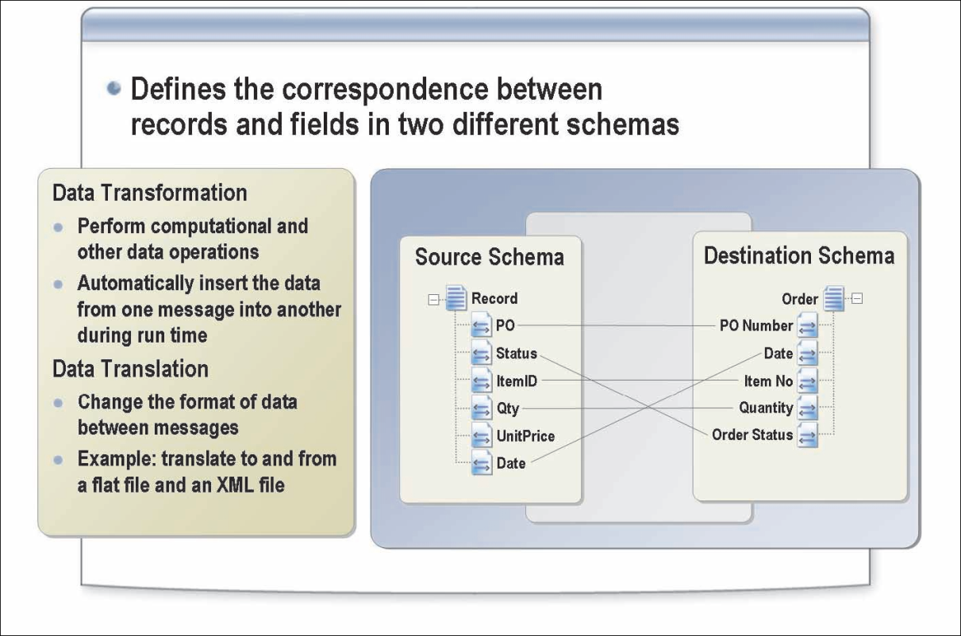
BizTalk Map
A map is the XML file that defines the correspondence between the records and fields in one schema and the records and fields in another schema. You create a map when you want to transform or translate data that you receive or send from one schema to another.
Notes:
Data transformation is the process of creating a correspondence between the records and fields in a source schema and the often different records and fields in a destination schema.
Data transformation can also be used to perform operations such as:
Averaging data from a looping record and sending the output to a single field in the destination schema.
Converting character data to its ASCII format.
Adding data to or subtracting data from one or more records and sending the result to a single field in the destination schema.
Data translation is the process of changing the format of an instance message. If your internal processes utilize only XML data, but your trading partner needs to receive instance messages in a flat file format, you can perform the necessary translation before you send such messages to your trading partner.
Data translation can be especially helpful in solving enterprise application integration problems by rendering a given type of message into alternative formats required by existing systems.
Types pf Mapping
Basic Mapping
This type of mapping involves copying a value from an element or attribute that occurs once in an input instance message to an element or attribute that occurs once in an output instance message.
Complex Mapping
Complex mapping involves records or fields that can occur multiple times for a single instance of the Record node or Field Element node in the schema tree. This type of variable count mapping is called looping.
BizTalk Mapper consists of the following views within the Visual Studio .NET shell:
Destination schema tree view. This view displays the schema that describes the transformed instance message to be processed by BizTalk Server.
Source schema tree view. This view displays the schema that describes the incoming instance message. The links that define the mapping originate from the source schema tree view, passing through the map zone view and ultimately to the destination schema tree view.
Map grid view. This view is located between the source and destination schemas, and contains the links and functoids that control how data in a source instance message is transformed to the destination schema. You work actively in this view to construct your map

Slide 38
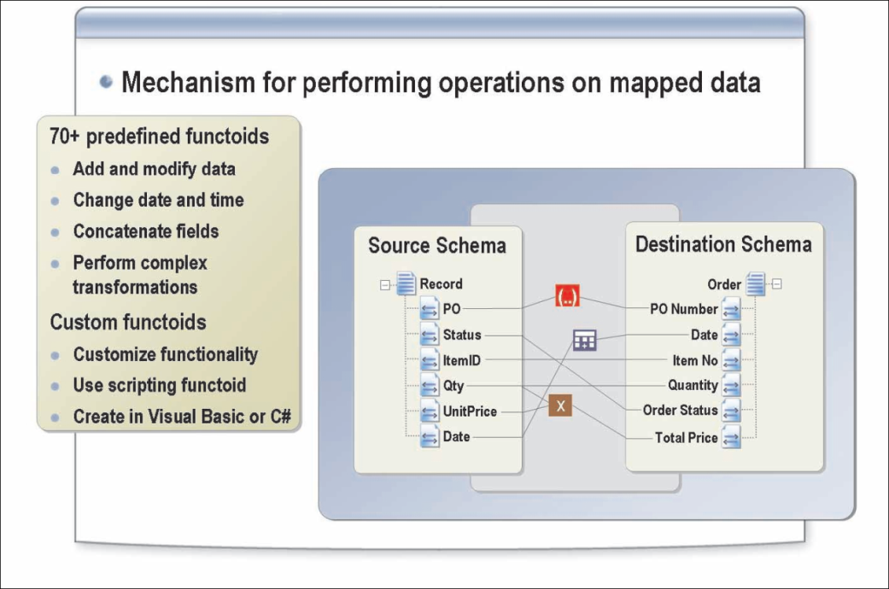
Functoids
Functoids perform calculations by using predefined formulas to process specific field values. These calculations are executed based on the designated order of the records and fields.
By linking a functoid to nodes in both the source schema and the destination schema, data can be concatenated; values added together, date and time information can be modified, and so forth.
If you want to implement functionality that is not available in the functoids that are included with BizTalk Mapper, you can create custom functionality by using the Scripting functoid, which allows you to access custom script or code during run time to perform functions not otherwise available. For example, you can call a COM object or Microsoft .NET object at run time by using the Scripting functoid and writing your own custom script.
BizTalk Server 2004 supports the following languages for the Scripting functoid:
C, Jscript, Microsoft Visual Basic® .NET, Extensible Stylesheet Transformation (XSLT), XSLT Call Templates

Slide 39
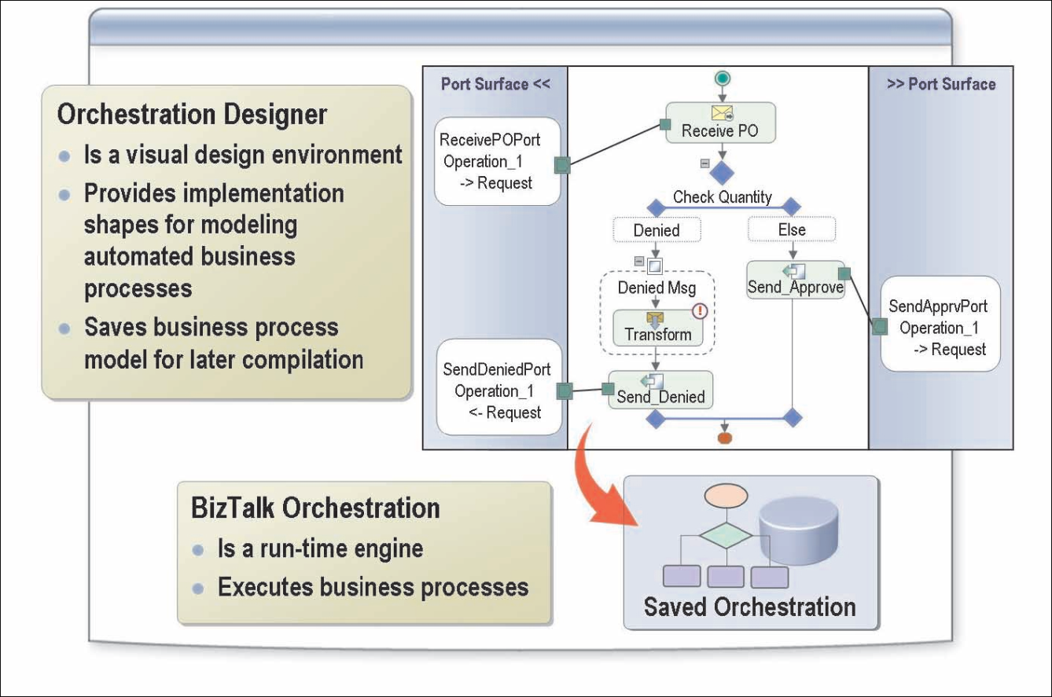
BizTalk Orchestration
Orchestration Designer
You can use BizTalk orchestration to create detailed representations of business processes that can be implemented programmatically within an integrated design environment called Orchestration Designer. This design environment provides a versatile drawing surface and a comprehensive set of implementation tools..

Slide 40
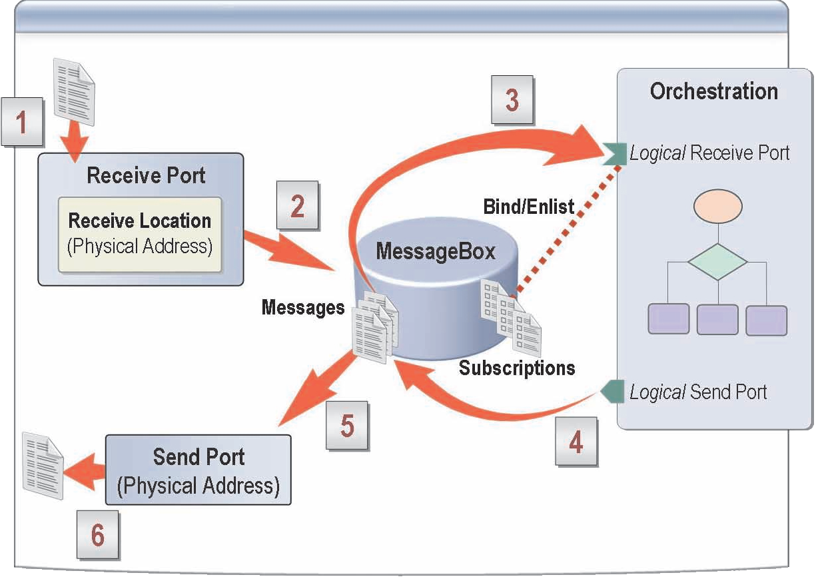
Physical Ports vs. Logical Ports
Physical ports are used to receive and send messages between BizTalk Server and the outside world. Physical ports are configured and managed by using BizTalk Explorer.
Logical ports are used within BizTalk Server to pass messages to and from a BizTalk orchestration. Logical ports are configured by using Orchestration Designer and appear on the Port Surface areas.
Notes:
A port binding specifies the entry points into the BizTalk-based application, and is used to associate the application with physical ports. The port binding contains configuration information that specifies where and how a message is to be sent or received.
Web Service References
If your project contains a reference to a Web service, Orchestration Designer will detect the reference and make available a corresponding Web port type.
You simply add a port to your orchestration and assign it an existing Web port type, and BizTalk Server will provide a complete Web port.
Specify Later
You can bind your port either to a receive location or to a send port. If you do not have all of the information you need to specify a physical location, you can choose the Specify Later port binding option in Orchestration Designer, and then you need only to specify the port type that describes the port.
The information about the actual location will be specified separately, after the application has been deployed, either by an administrator working in BizTalk Explorer or programmatically, perhaps by using a script.
Dynamic Binding
If you will not know the location of a communication until run time, you can use dynamic binding. For example, you might specify the location based on a property of an incoming message.

Slide 41
Concepts

Slide 42
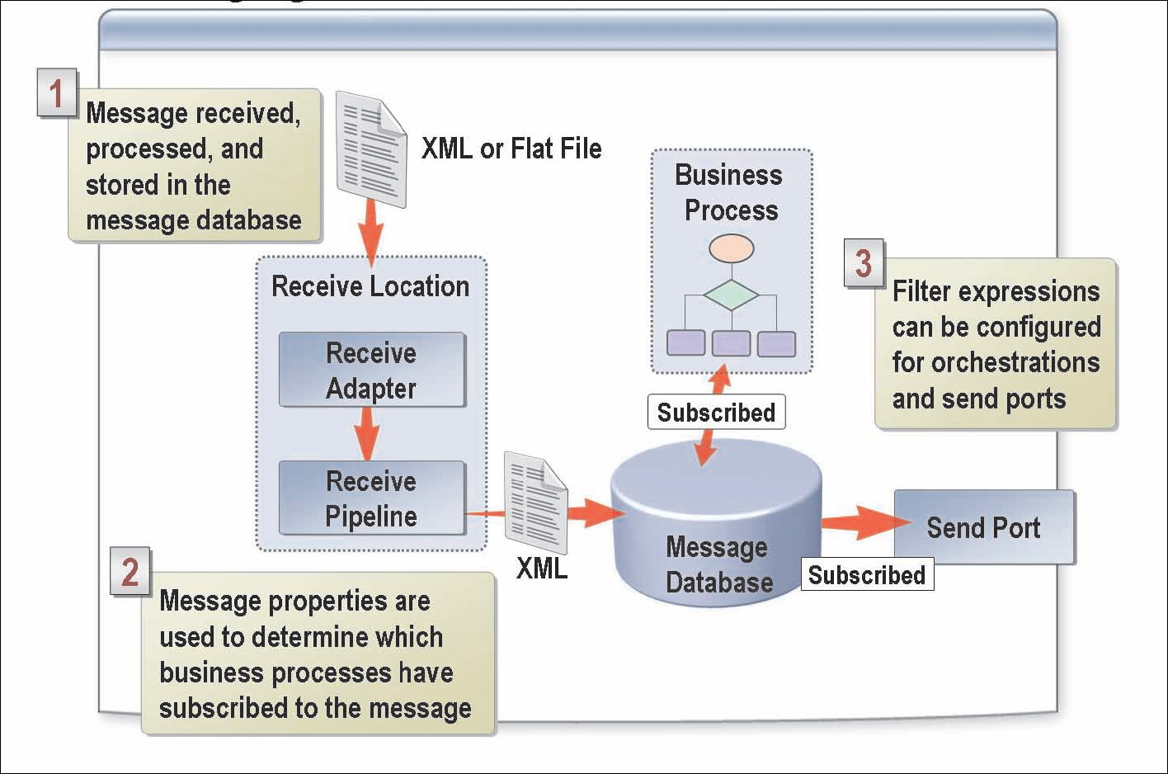
What Is the Publish and Subscribe Messaging Model?
BizTalk Server uses a publish and subscribe (or pub/sub) messaging infrastructure that is highly scalable at both database and processing levels.
This publish and subscribe routing mechanism can manage large volumes of messages (including large messages) and interact with a wide variety of backend systems.
Subscriptions are criteria that describe which message types each business process will receive. Business processes hold subscriptions to specified types of messages; each subscription allows the business process holding it to initiate or continue the processing of one type of message.

Slide 43
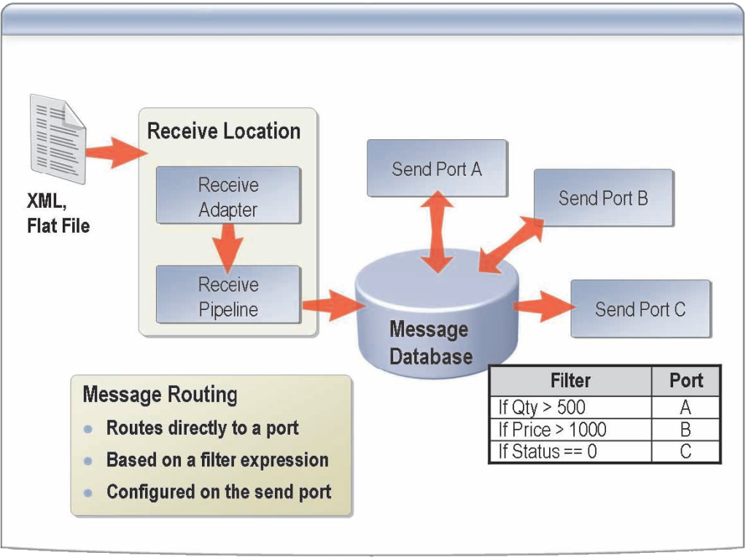
What Is Message Routing?
To enable content-based routing, you must perform the following steps:
1. From the source schema for the incoming message, promote the field nodes that will contain the filters.
2. Create and configure both a receive port and a receive location for incoming messages.
3. Create a send port, and configure a filter on the send port to create a subscription for messages that meet the conditions of the filter expression.
4. Enlist and start the send port.
A typical BizTalk Server business process involves receiving, processing, and sending messages. At times, you may receive types of messages (such as partner-to-partner correspondence) that do not require intensive processing in an orchestration, and could therefore benefit from a simpler solution.
Content-based routing eliminates the need for message subscriptions for messages that are deterministically bound to specific ports, and provides additional flexibility for users who want to route messages based on context properties (or simply based on receive port configuration properties).

Slide 44
Para informação adicional:
EMAIL: sandro.pereira@devscope.net
BLOG: http://sandroaspbiztalkblog.wordpress.com
TEL / PHONE + 351 22 375 13 50 | FAX +351 22 375 13 52
www.devscope.net
info@devscope.net

